Slide 1
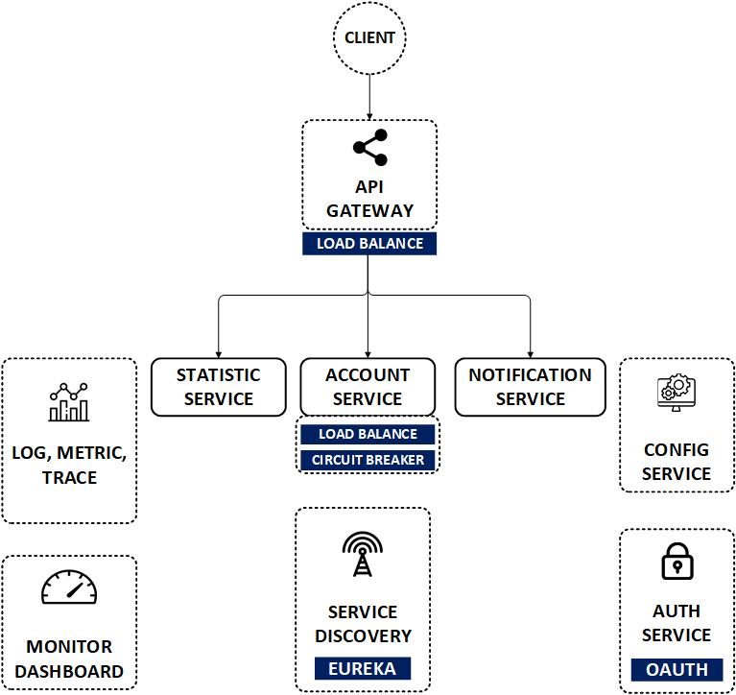

Spring Cloud Gateway
www.jmaster.io/course/microservices-with-spring-cloud

Slide 2
Spring Cloud Gateway
A library for building an API Gateway Server, on top of Spring WebFlux
A simple, yet effective way to route to APIs of hidden services behind (Reserved Proxy)
Provide cross cutting concerns such as: security, monitoring/metrics, and resiliency.

Slide 3
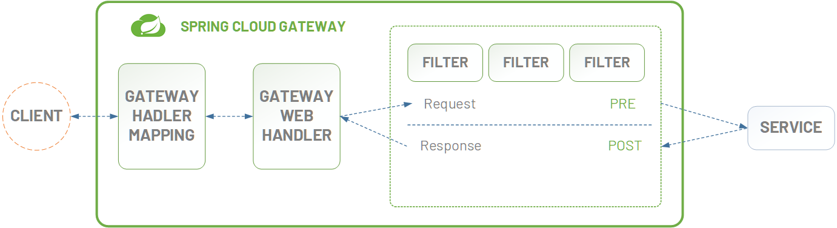

Slide 4
Features
Able to match routes on any request attribute.
Easy to write Predicates and Filters
Circuit Breaker & Load balancer integration
Path Rewriting

Slide 5
